Slide 1

Lecture 10: Arrays
AP Computer Science Principles

Slide 2
Arrays

Slide 3
Arrays
array: object that stores many values of the same type.
  element: One value in an array.
  index: A 0-based integer to access an element from an array.
index | 0 | 1 | 2 | 3 | 4 | 5 | 6 | 7 | 8 | 9
value | 12 | 49 | -2 | 26 | 5 | 17 | -6 | 84 | 72 | 3
element 0
value is 12
element 4
value is 5
element 9
value is 3

Slide 4
Array declaration
type[] name = new type[length];
  Example:
  int[] numbers = new int[10];
index | 0 | 1 | 2 | 3 | 4 | 5 | 6 | 7 | 8 | 9
value | 0 | 0 | 0 | 0 | 0 | 0 | 0 | 0 | 0 | 0

Slide 5
Array declaration, cont.
The length can be any integer expression.
  int x = 2 * 3 + 1;
  int[] data = new int[x % 5 + 2];
Each element initially gets a "zero-equivalent" value.
Type | Default value
int | 0
float | 0.0
boolean | false
String or other object | null (means, "no object")

Slide 6
Accessing elements
name[index] // access
name[index] = value; // modify
  Example:
  numbers[0] = 27;
  numbers[3] = -6;
  println(numbers[0]);
  if (numbers[3] < 0) {
  println("Element 3 is negative.");
  }
index | 0 | 1 | 2 | 3 | 4 | 5 | 6 | 7 | 8 | 9
value | 27 | 0 | 0 | -6 | 0 | 0 | 0 | 0 | 0 | 0
index | 0 | 1 | 2 | 3 | 4 | 5 | 6 | 7 | 8 | 9
value | 0 | 0 | 0 | 0 | 0 | 0 | 0 | 0 | 0 | 0

Slide 7
Arrays of other types
  float[] results = new float[5];
  results[2] = 3.4;
  results[4] = -0.5;
  boolean[] tests = new boolean[6];
  tests[3] = true;
index | 0 | 1 | 2 | 3 | 4
value | 0.0 | 0.0 | 3.4 | 0.0 | -0.5
index | 0 | 1 | 2 | 3 | 4 | 5
value | false | false | false | true | false | false

Slide 8
Out-of-bounds
Legal indexes: between 0 and the array's length - 1.
  Reading or writing any index outside this range will throw an ArrayIndexOutOfBoundsException.
Example:
  int[] data = new int[10];
  println(data[0]); // okay
  println(data[9]); // okay
  println(data[-1]); // exception
  println(data[10]); // exception
index | 0 | 1 | 2 | 3 | 4 | 5 | 6 | 7 | 8 | 9
value | 0 | 0 | 0 | 0 | 0 | 0 | 0 | 0 | 0 | 0

Slide 9
Accessing array elements
  int[] numbers = new int[8];
  numbers[1] = 3;
  numbers[4] = 99;
  numbers[6] = 2;
  int x = numbers[1];
  numbers[x] = 42;
  numbers[numbers[6]] = 11; // use numbers[6] as index
x
x | 3
index | 0 | 1 | 2 | 3 | 4 | 5 | 6 | 7
value
index | 0 | 1 | 2 | 3 | 4 | 5 | 6 | 7
value | 0 | 3 | 11 | 42 | 99 | 0 | 2 | 0
numbers

Slide 10
Arrays and for loops
It is common to use for loops to access array elements.
  for (int i = 0; i < 8; i++) {
  print(numbers[i] + " ");
  }
  println(); // output: 0 3 11 42 99 0 2 0
Sometimes we assign each element a value in a loop.
  for (int i = 0; i < 8; i++) {
  numbers[i] = 2 * i;
  }
index | 0 | 1 | 2 | 3 | 4 | 5 | 6 | 7
value | 0 | 2 | 4 | 6 | 8 | 10 | 12 | 14

Slide 11
The length field
An array's length field stores its number of elements.
  name.length
  for (int i = 0; i < numbers.length; i++) {
  System.out.print(numbers[i] + " ");
  }
  // output: 0 2 4 6 8 10 12 14
What expressions refer to:
  The last element of any array? numbers[numbers.length-1]
  The middle element? numbers[numbers.length/2]

Slide 12
Quick array initialization
  type[] name = {value, value, … value};
  Example:
  int[] numbers = {12, 49, -2, 26, 5, 17, -6};
  Useful when you know what the array's elements will be
  The compiler figures out the size by counting the values
index | 0 | 1 | 2 | 3 | 4 | 5 | 6
value | 12 | 49 | -2 | 26 | 5 | 17 | -6

Slide 13
"Array mystery" problem
traversal: An examination of each element of an array.
What element values are stored in the following array?
  int[] a = {1, 7, 5, 6, 4, 14, 11};
  for (int i = 0; i < a.length - 1; i++) {
  if (a[i] > a[i + 1]) {
  a[i + 1] = a[i + 1] * 2;
  }
  }

Slide 14
"Array mystery" problem
traversal: An examination of each element of an array.
What element values are stored in the following array?
  int[] a = {1, 7, 5, 6, 4, 14, 11};
  for (int i = 0; i < a.length - 1; i++) {
  if (a[i] > a[i + 1]) {
  a[i + 1] = a[i + 1] * 2;
  }
  }
index | 0 | 1 | 2 | 3 | 4 | 5 | 6
value
index | 0 | 1 | 2 | 3 | 4 | 5 | 6
value | 1 | 7 | 10 | 12 | 8 | 14 | 22

Slide 15
Limitations of arrays
You cannot resize an existing array:
  int[] a = new int[4];
  a.length = 10; // error
You cannot compare arrays with == or equals:
  int[] a1 = {42, -7, 1, 15};
  int[] a2 = {42, -7, 1, 15};
  if (a1 == a2) { ... } // false!
  if (a1.equals(a2)) { ... } // false!
An array does not know how to print itself:
  int[] a1 = {42, -7, 1, 15};
  print(a1); // [I@98f8c4]

Slide 16
printArray(array)
  int[] e = {1, -2, 4};
  printArray(e);
  Output:
  [0] 1
  [1] -2
  [2] 4

Slide 17
What does it do?
int numBalls = 100;
int[] x = new int[numBalls];
int[] y = new int[numBalls];
int[] xspeed = new int[numBalls];
int[] diameter = new int[numBalls];
void setup(){
size(600,600);
for(int i = 0; i < x.length; i++){
x[i] = int(random(0,width));
y[i] = int(random(0,height));
diameter[i] = int(random(10,100));
xspeed[i] = int(random(-5, 5));
if(xspeed[i] == 0)
xspeed[i] = -2;
}}
(continue on next slide..)

Slide 18
What does it do?
void draw(){
background(255);
fill(255,0,0);
for(int i = 0; i < x.length; i++){
x[i] += xspeed[i];
ellipse(x[i], y[i], diameter[i], diameter[i]);
if(x[i] > width || x[i] < 0)
xspeed[i] *= -1;
}
}

Slide 19
Finding Index of Largest Value
Given an array, return the index of the largest value in the array. If there are multiple largest values, return the index of the first one.
int[] a = {1,-5,56,7,56,23};
int index = indexLargest(a); // index = 2
int indexLargest(int[] array){
int index = 0;
for(int i = 1; i < array.length; i++){
if(array[i]>array[index])
index = i;
}
return index;
}

Slide 20
Arrays
String[] a = [“hip”, “hip”];
//hip hip arrays!

Slide 21
Arrays
Why did the programmer quit his job?
Because he didn’t get arrays.
(He didn’t get arrays and a raise.)

Slide 22
Array Lab 1
  Write the method average which accepts an int array and returns the average of the values.
  Write the method countAboveAve which accepts an int array and returns the number of values that are above the average. You must call average.
  Write two methods largest and smallest which accept an int array and returns the largest value and smallest value, respectively. DO NOT USE sort method in Arrays.
  float average(int[] array){}
  int countAboveAve(int[] array){}
  int largest(int[] array){}
  int smallest(int[] array){}

Slide 23
Lab 1 Outline
Write the setup() method to test your methods.
void setup(){
}
float average(int[] array){
}
int countAboveAve(int[] array){
}
int largest(int[] array){
}
int smallest(int[] array){
}

Slide 24
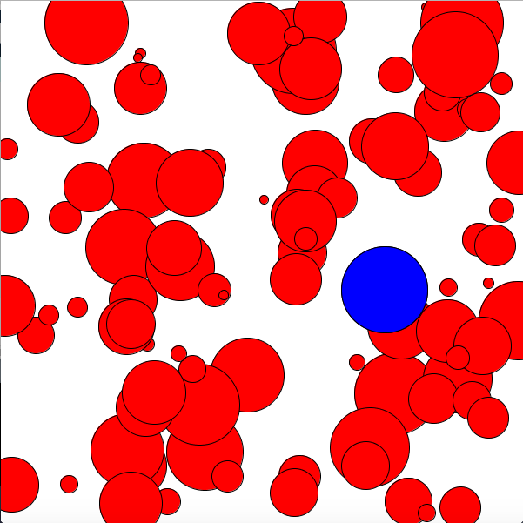
Array Lab 2
Modify the what does it do program by adding the method indexLargest which returns the index of the largest ball. Draw this largest ball in blue. The .pde file can be found on Classroom.

Slide 25
Homework
Read and reread these lecture notes.
Complete the problem set on arrays.
Complete the labs.

Slide 26
References
Part of this lecture is taken from the following book.
1) Stuart Reges and Marty Stepp. Building Java Programs: A Back to Basics Approach. Pearson Education. 2008.

